Slide 1
Introduction to ECC
Elliptic Curve Cryptography (ECC) was discovered in 1985 by Koblitz and Miller.
R.Saravanan Senior Prof of IT VIT

Slide 2
Why Elliptic Curve Cryptography?
The security of RSA algorithm is based on the intractability of integer factorization problem
There are sub-exponential time algorithms to solve the integer factorization problems.
The security of ECC is based on the hardness of Elliptic Curve Discrete Logarithm Problem (ECDLP).
The algorithms known to solve the ECDLP have fully exponential running time.
R.Saravanan Senior Prof of IT VIT

Slide 3
The resulting public-key systems provide relatively small block size, high speed, and high security.
Therefore, a desired security level can be obtained by smaller keys in elliptic curve systems than RSA.
Eg., a 160-bit ECC key provides the same level of security as a 1024 bit RSA Key.
The advantages gained from ECC include speed, efficient use of power, bandwidth and storage.
R.Saravanan Senior Prof of IT VIT

Slide 4
Key sizes for equivalent security levels
Symmetric ECC DH/DSA/RSA
80 160 1024
128 256 3072
192 384 7680
256 512 15360
R.Saravanan Senior Prof of IT VIT

Slide 5
Elliptic curves over Reals
General equation of elliptic curve is:
y²+axy+by = x³ +cx²+dx + e (used to calculate circumference of an ellipse – not describe ellipse)
Special case used in ECC is: y² = x³ + ax + b, where x, y, a and b are real numbers.
E(a,b)={points on the elliptic curve described by the above equation} U {O}.
i.e., E(a,b)={(x,y): y² = x³ + ax + b} U {O},
where O is a special point called the point at infinity ( identity element)..
If 4a³ + 27b² is not 0, then E(a,b) forms a group
If the equation x³ + ax + b=0 has distinct roots, then the discriminant 4a³ + 27b² is not 0
R.Saravanan Senior Prof of IT VIT

Slide 6
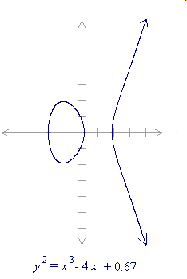
Geometric Interpretation of
E(-4,0.67)
R.Saravanan Senior Prof of IT VIT

Slide 7
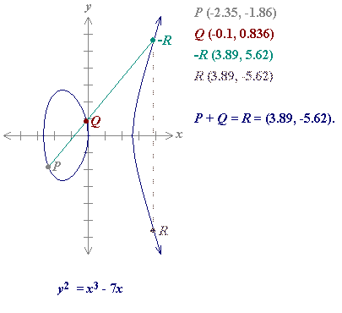
Add P and Q
Principle: Sum of any three points of the curve on a straight line is 0
R.Saravanan Senior Prof of IT VIT

Slide 8
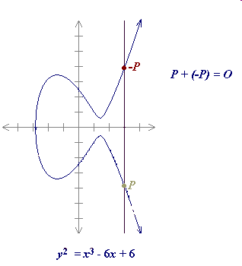
Add P and -P
Vertical lines have
no third intersection point with E(a,b)
Find reflection of a point on x axis to get its negation.
R.Saravanan Senior Prof of IT VIT

Slide 9
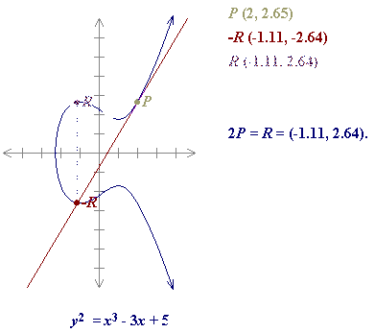
Doubling the Point P =>2P
R.Saravanan Senior Prof of IT VIT

Slide 10
Algebraic Representation of Operations on Elliptic Curve
Let P = (x_{P},y_{P}) and Q = (x_{Q},y_{Q}), P & Q are not negative of each other
Let P + Q = R and s = (y_{P} - y_{Q}) / (x_{P} - x_{Q}) .
Then coordinates of R are: x_{R} = s² - x_{P} - x_{Q} and y_{R} = -y_{P} + s(x_{P} - x_{R})
Note: s is the slope of the line through P and Q.
R.Saravanan Senior Prof of IT VIT

Slide 11
Doubling a point
When y_{P} is not 0, let 2P = R and
s = (3x_{P}² + a) / (2y_{P} ). Then coordinates of R are :
x_{R} = s² - 2x_{P} and y_{R} = -y_{P} + s(x_{P} - x_{R})
R.Saravanan Senior Prof of IT VIT

Slide 12
Negation of Point
The negative of the point P = (x_{P}, y_{P}) is the point -P = (x_{P}, - y_{P}).
nP is calculated using repeated additions.
Eg: 5P = P+P+P+P+P as :
P+P=2P
2P+2P=4P
4P+P=5P
Or Find 2P and then 3P, finally 5P
Or Find 2P and then 2*2P, finally P+4P
R.Saravanan Senior Prof of IT VIT

Slide 13
Subtraction of points
Let P & Q be points.
To find P-Q:
  First find negation: -Q
  Then find addition: P + (-Q)
R.Saravanan Senior Prof of IT VIT

Slide 14
E C over Finite field F_{P}
The equation of EC over finite field F_{P} is:
y² mod p = x³ + ax + b mod p.
If 4a³ + 27b² mod p is not 0, then E_{p}(a,b), the set points on the elliptic curve, forms a group. p is a prime no
This type of elliptic curves, called as prime curves, are useful for s/w implementations as it requires less operations on bits
R.Saravanan Senior Prof of IT VIT

Slide 15
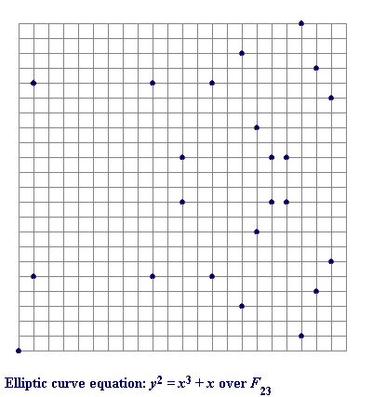
Example E₂₃(1, 0)
R.Saravanan Senior Prof of IT VIT

Slide 16
Arithmetic on EC over F_{P}
The negative of the point P = (x_{P}, y_{P}) is the point: -P = (x_{P}, -y_{P} mod p).
If P and Q are distinct points such that P is not -Q, then let P + Q = R.
Let s = ( (y_{P} - y_{Q}) / (x_{P} - x_{Q}) ) mod p .
Then Coordinates of R: x_{R} = (s² - x_{P} – x_{Q}) mod p and y_{R} = ( s(x_{P} - x_{R}) -y_{P} ) mod p
Note: s is the slope of the line through P and Q.
R.Saravanan Senior Prof of IT VIT

Slide 17
Doubling the point P (if y_{P} is not 0)
Let 2P = R and s =((3x_{P}² + a) / (2y_{P} ))mod p.
Then Coordinates of R are :
x_{R} = ( s² - 2x_{P} )mod p and
y_{R} = ( s(x_{P} - x_{R}) -y_{P} )mod p
R.Saravanan Senior Prof of IT VIT

Slide 18
E C Over finite filed F₂^{M}
The equation of EC over finite field F₂^{M} is:
y² + xy = x³ + ax² + b
If b is non zero, then E₂^{M} (a,b), the set points on the elliptic curve, forms a group
This type of elliptic curves, called as binary curves, are useful for hardware implementations as it requires few logic gates
R.Saravanan Senior Prof of IT VIT

Slide 19
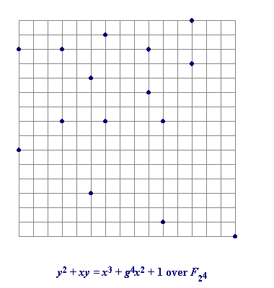
Example E₂⁴(₂⁴,1)
R.Saravanan Senior Prof of IT VIT

Slide 20
Arithmetic on EC over F₂^{M}
Adding distinct points P and Q
The negative of the point P = (x_{P}, y_{P}) is the point
-P = (x_{P}, x_{P} + y_{P}).
If P and Q are distinct points such that P is not -Q, then let P + Q = R and s = (y_{P} + y_{Q}) / (x_{P} + x_{Q}) .
Then coordinates of R are:
x_{R} = s² + s + x_{P} + x_{Q} + a and
y_{R} = s(x_{P} + x_{R}) + x_{R} + y_{P}.
R.Saravanan Senior Prof of IT VIT

Slide 21
Doubling the point P
If x_{P} = 0, then 2P = O. If x_{P} is not 0, let 2P = R and s = x_{P} + y_{P} / x_{P}.
Then coordinates of R are:
x_{R} = s²+ s + a and y_{R} = x_{P}² + (s + 1)x_{R}
R.Saravanan Senior Prof of IT VIT

Slide 22
ECC Key Generation
Global public: Elliptic Curve: E_{q}(a,b), Base point G on elliptic curve with large order n.
Sender A: Select a no. n_{A} < n (PVT)
Calculate p_{A} = n_{A} * G (PUB)
Receiver B: Select a no. n_{B} < n (PVT)
Calculate p_{B} = n_{B} * G (PUB)
R.Saravanan Senior Prof of IT VIT

Slide 23
ECC - Key Exchange
Let K be the secret key to be exchanged
Sender A: Calculate K = n_{A} * p_{B}
Receiver B: Calculate K = n_{B} * p_{A}
Verification: Prove: n_{A} * p_{B} = n_{B} * p_{A}
n_{A} * p_{B} = n_{A} * n_{B} * G
= n_{B} * n_{A} * G , since commutative
= n_{B} * p_{A}
R.Saravanan Senior Prof of IT VIT

Slide 24
ECC - Encryption & Decryption
Given:
Elliptic curve E_{q}(a,b); q is either prime or 2^{n};
Base point G on elliptic curve with large order n. Message m to be encrypted.
Step1. Encode the message as (x, y) of a point P_{m}. i.e., m → P_{m}:(x,y) on the elliptic curve
Step2. Generate (PUB, PVT) Key pairs
R.Saravanan Senior Prof of IT VIT

Slide 25
Step3. (Encryption) Let k be the random no (+ve integer) selected by A (k is known to only A).
The cipher text c_{m}= ( kG, P_{m}+kP_{B})
Step 4. (Decryption).
P_{m} = 2nd part of c_{m} – n_{B}* 1st part of c_{m}
i.e., P_{m} = P_{m}+kP_{B} - n_{B}* kG,
If k or private key n_{B} is known, then message P_{m} can be calculated easily from cipher text c_{m.}
Here finding value of k is a ECDLP.
R.Saravanan Senior Prof of IT VIT

Slide 26
ECC Example
Given Elliptic Curve: E_{p}(-1,188) with p=175. Let G = (0,376).
Let message m be encoded as p_{m}=(562,201), and random no selected be k = 386.
Receiver’s public key be P_{B}= (201,5).
Find the cipher text.
Ans: ( (676,558), (385,328) )
R.Saravanan Senior Prof of IT VIT

Slide 27
Computational Efforts for Cryptanalysis
Computing power needed to compute ECDLP using Pollard rho method.
Key size MIPS – years
160 8.5 X 10¹¹
186 7.0 X 10¹⁵ 234 1.2 X 10²³ 354 1.4 X 10¹¹ 426 9.2 X 10⁵¹
R.Saravanan Senior Prof of IT VIT

Slide 28
Computing power needed to compute integer factorization using NFS method.
Key size MIPS – years
512 3 X 10⁴
768 2 X 10⁸ 1024 3 X 10¹¹ 1280 1 X 10¹⁴ 1536 3 X 10¹⁶
2048 3 X 10²⁰
R.Saravanan Senior Prof of IT VIT

